Slide 1
Technocracy, populism and good governance What Nigeria can teach us about the global crisis of democracy
Dr Portia Roelofs
portia.roelofs@st-annes.ox.ac.uk
African Studies Centre, Oxford 29th October 2020

Slide 2
Normative Politics in Africa:
Paying attention to:
The normative political commitments of those we study and role of ideas in politics
Politics in Africa as a source of theorising normative political concepts
The normative assumptions that shape scholars work
Structure of the presentation:
The discipline: African Studies and Aid Industry
Southwest Nigeria 1999-2019 [Fieldwork]
Global crisis of Democracy

Slide 3
Overview of the argument:
Governance consists of three dimensions:
Epistemic --- Social -- Material --
The good governance agenda was part of a wider shift towards epistemic governance.
Populism is a response to the neglect of the social dimensions of governance.

Slide 4
Good governance and Neo-patrimonialism
The discipline: African Studies and Aid Industry
Key terms that emerged in the 1990s:
SAPs failed -> Institutions: Accountability, Transparency, Efficiency. (World Bank 1992).
Neo-patrimonialism: resurgence in 1990s (Van de Walle, Bratton)
Why are we still talking about these terms?
Subject to extensive critique (Mkandawire, Di Grassi) BUT still influential

Slide 5
1st critique of the Good Governance Agenda
The discipline: African Studies and Aid Industry
1.a) Imposition of Western-style institutions / Conditionality (Abrahamsen 2000, 2004) 1. b) Neo-liberalism: access to markets for international capital. (Mkandawire 2009)
→ Choiceless Democracies (Mkandawire 1998, Przeworski 1999)
→ Desire for Afro-centric Good Governance (Adejumo Ayibiowu)
But what about “home grown good governance states”? Sub-national?

Slide 6
2nd critique: Good Governance a Technocracy
The discipline: African Studies and Aid Industry
Apolitical:
Development as a technical problem, susceptible to a “managerial fix”. (Leftwich 1993, 1994, Polzer 2001)
Technocracy vs democracy:
“Technocratic policy-making and democratic accountability” (Bangura + Mkandawire at UNRISD) “Politics of insulation” e.g. Central Banks
Good governance as epistocracy. Knowledge-based rule. (Bhatia, Gunn, Holst)
Staying power? Arrived into specific intellectual and political context

Slide 7
Revenge of Society: pathologizing the social
The discipline: African Studies and Aid Industry
1980s: scholarly disillusionment with political and economic failure in Africa. Where to locate the source of failure?
“Revenge of Society”. (Bayart, Political Domination in Africa)
Belief among Western scholars that, in Africa, the social had overwhelmed the political.
E.g. Joseph 1979 versus 1987
Society had corrupted the state (Martinussen)
Neo-patrimonialism: social relations in Africa as a liability.

Slide 8
Technocracy to the rescue! Epistemic --- Social -- Material --
The discipline: African Studies and Aid Industry
→ The binary of good governance vs. neopatrimonialism is only one iteration of this wider assertion of the value of the epistemic over the social dimension of governance.
Rise of markets accompanied by epistocratic gate-keeping:
New Public Management, Audit Culture, rise of supra-national institutions. “Governing by rules and ruling by numbers” (Schmidt)

Slide 9
Foregrounding the epistemic dimensions of governance
The discipline: African Studies and Aid Industry
Mistrust of social relations in politics has deeper intellectual roots:
Liberal theory aims to strip away social dimensions of power: power is accountable when it is impersonal and anonymous (Warren 1999).
Freedom conceived as rationality and independence. Focus on individuals, not relations.
Indeed, liberal democracy is based on individuals, not society (Ake, Lumumba-Kasongo).
Good Governance Agenda lives on in the discipline through principal-agent models.

Slide 10
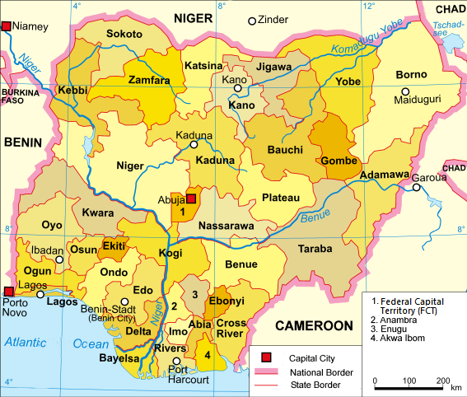
Southwest Nigeria 1999-2019
‘Home-grown’ good governance states
This Photo by Unknown Author is licensed under CC BY-SA

Slide 11
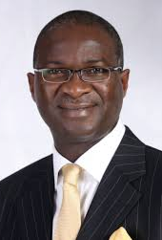
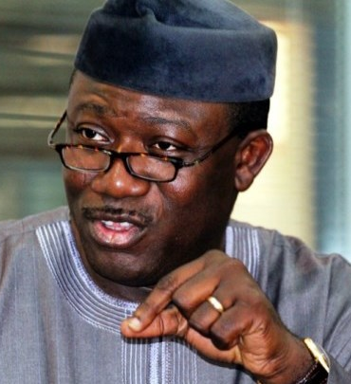
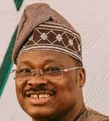
Lagos Model in Southwest Nigeria
Southwest Nigeria 1999-2019
State | 1999-2003 | 2003-07 | 2007-11 | 2011-15 | 2011-2015
Lagos | Bola Tinubu |  | Babatunde Fashola
 |  |  | 2010-2014
Ekiti |  |  | Kayode Fayemi
Oyo |  |  |  |  | Abiola Ajimobi
Led by State Governors.
Yoruba progressives, laying claim to legacy of Obafemi Awolowo -> Epistocratic rule
All member of what eventually became the All Progressive’s Congress (APC)

Slide 12
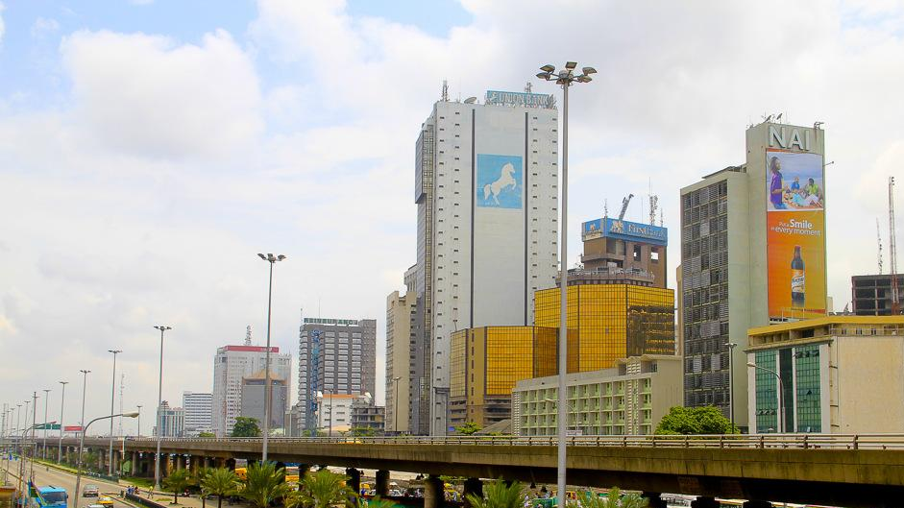
The Lagos Model
Southwest Nigeria 1999-2019
Private sector led development with strong state control of public space
Political and economic base outside of PDP-controlled oil revenues
→ Key words: Performance, excellence, “exposure”
Policies: law and order, roads and infrastructure, urban renewal, waste management
Good governance reforms: civil service reform, enabling environment for investors, tax reform and modernisation.

Slide 13
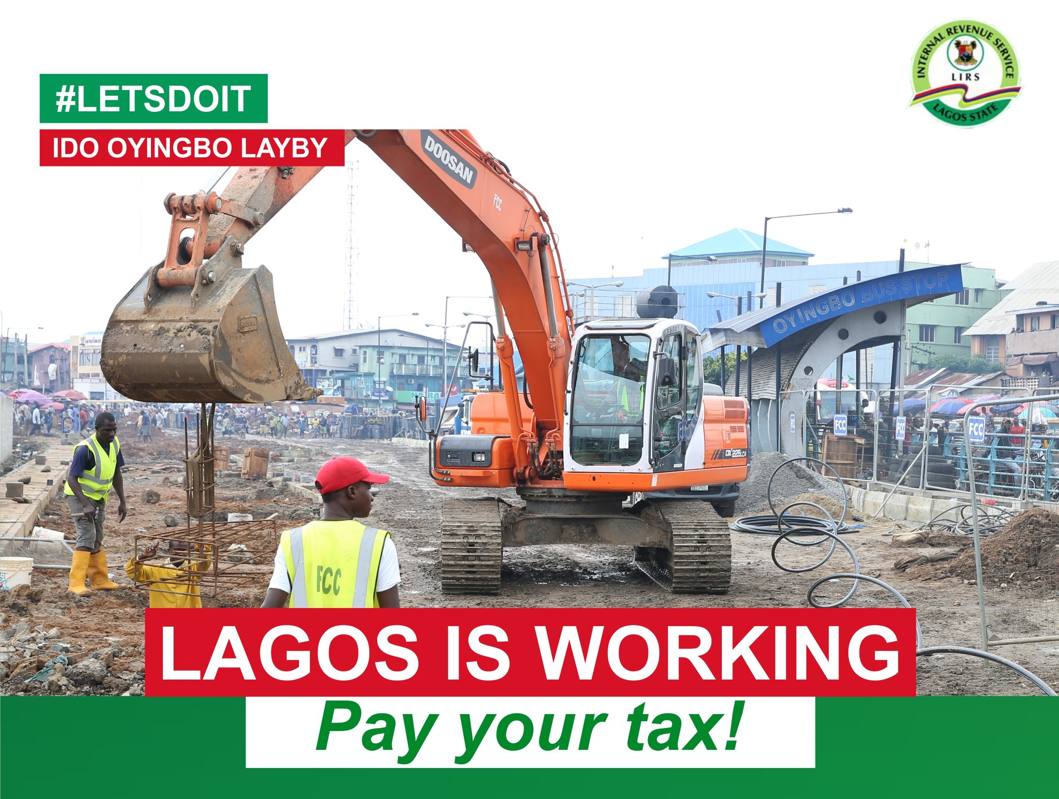
Lagos Model = technocratic good governance (sort of)
Global crisis of Democracy
Aspiration to transform not only governance but politics: “performance” + social contract.
Tax receipts increased from N600m to N7bn a month between 1999 and 2007. In 2010 HDI = India.
Tinubu re-elected 2003, then Fashola 2007 and 2011.
DFID, World Bank: Lagos model is a template of good governance for the rest of Nigeria to copy. “The Lagos miracle”
[Caveats…]

Slide 14
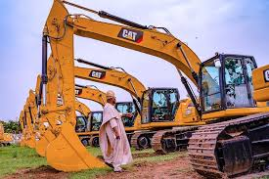
The Lagos model in Ekiti and Oyo
Southwest Nigeria 1999-2019
Similar package of policies and reforms backed up by less economic muscle.
Trade offs much sharper. More vulnerable to electoral challenge.
Ekiti 2014 : Fayemi loses to Ayo Fayose who subsequently appoints a special adviser for “Stomach Infrastructure”.
Oyo 2015 campaign: Ajimobi is accused of“neglecting the masses in favour of plants and flowers.”
→ Different forms of material politics?

Slide 15
What’s wrong with the Lagos Model?
Southwest Nigeria 1999-2019
Lack of attention to social dimensions of governance:
Fayemi: “insensitive”, “lacks human face”, “not people-oriented”.
Ajimobi was accused of“neglecting the masses in favour of plants and flowers.”
Tension between supposed ‘good governance’ and the social relations appropriate to democracy:
Inaccessible: “the office has gone to his head”, “cut himself off”
→ Same debates about the “Politics of insulation”
Embedded in suspicious social networks: Fayemi “always going to Lagos”, “capital flight”

Slide 16
Socially-embedded good governance
Southwest Nigeria 1999-2019
Concept | Technocratic Good Governance conception | Popular socially-embedded conception
Accountability | Voters sanction or reward leaders for performance as measured by metrics | Accessibility – possibility of direct face-to-face contact (Paller, Husaini, Soo et al)
Transparency | Availability and accuracy of government data, budgets and documentation | Transparency in People – social networks legible (Governance article 2019)
 | Epistemic (+material) | Social

Slide 17
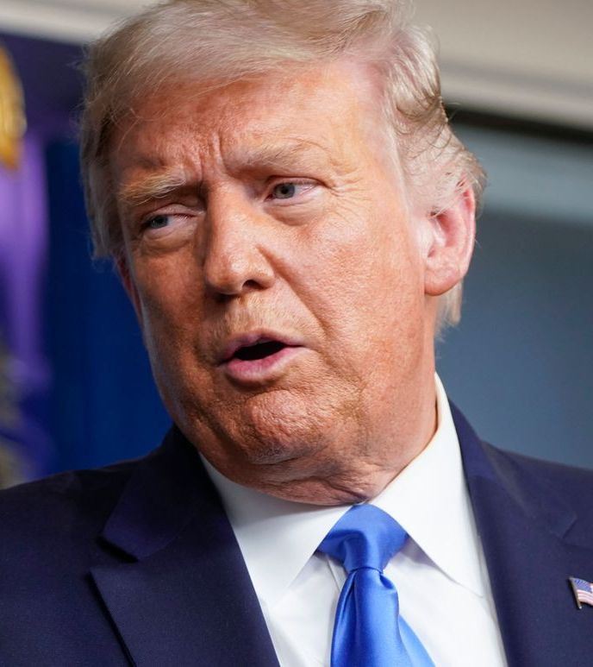
Stepping into the void:
Global crisis of Democracy
Increased use of populist appeals from across spectrum (Engler et al 2019) Yet most troubling is their successful use by far-right (i.e. Orban, Erdogan, Trump).
Politicians opportunistically draw on populist appeals to respond to this neglected desire for closeness and connection: i.e. Fayose
“Speak straight into the ear of the Governor”
“always in a meeting” vs. “he picks it himself”
Standard populist tropes: Unmediated connection, rejection of ‘high’ cultural forms of speech and comportment, ‘common man’.
Trump’s claim to “hide nothing” vs. drain the swamp = populist transparency (Fenster 2017)

Slide 18
Stepping into the void:
Global crisis of Democracy
Concept | Technocratic Good Governance conception | Popular socially-embedded conception | Populist
Accountability | Voters sanction or reward leaders for performance as measured by metrics | Accessibility – possibility of direct face-to-face contact | Exaggerated accessibility
Transparency | Availability and accuracy of government data, budgets and documentation | Transparency in People – social networks legible | Exaggerated transparency in people (denigration of transparency in data)
Dimension governance | Epistemic (+material) | Social | Exaggerated social

Slide 19
Review of the argument:
The discipline: African Studies and Aid Industry
Southwest Nigeria 1999-2019
Global crisis of Democracy
Governance consists of three dimensions:
Epistemic --- Social -- Material --
The good governance agenda was part of a wider shift towards epistemic governance.
Populism is a response to the neglect of the social dimensions of governance.

Slide 20
Isn’t the rise of populism an anti-system response to inequality (Piketty) and the changing material dimensions of governance? - Polanyi (Fraser, Hopkin) - BUT 1. role of education and 2. the state How should we respond? “Adults in the room” vs. “they don’t care about people like you”
Questions:
Global crisis of Democracy

Slide 21
Oyo and Ekiti: What happened after 2015?
Global crisis of Democracy
Southwest Nigeria 1999-2019
Oyo 2019:
PDP win: “redefining good governance with a focus on people-centred policies.”
Ekiti 2018:
Fayemi wins against Eleka of PDP, beating him in 12/16 LGAs, with an average increase in vote share of about 15%.
Return to epistemic governance? Or a change in material politics?

Slide 22
Thanks for listening! Portia.Roelofs@st-annes.ox.ac.uk

Slide 23
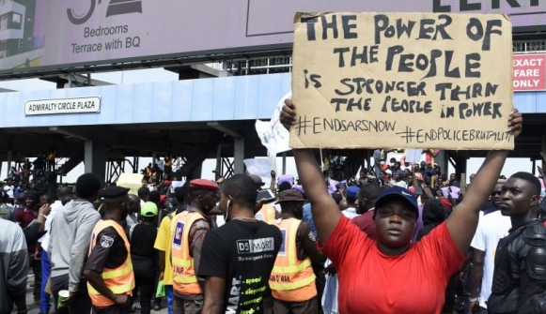
#EndSars
“What is “good governance”? Who determines what is good and bad governance? What yardsticks are applied? And why are these yardsticks applied only to Africa?”
Issa Shivji 2007
“What is striking … is the determination of African intellectuals not to succumb to the despair that suffuses commentary on the continent's current predicament. The debate [on democracy] proclaims, in many ways, faith in the desirability, indeed the moral obligation, of articulating collective social visions.”
Dickson Eyoh 1998
Links:
https://www.facebook.com/groups/205111409881162/
https://africasacountry.com/2020/10/end-police-brutality-in-nigeria-now/

Slide 24
Bibliography:
Ake, Claude. 1993. “The Unique Case of African Democracy.” International Affairs (Royal Institute of International Affairs 1944-) 69 (2): 239–244. https://doi.org/10.2307/2621592.
Leftwich, Adrian. 1993. “Governance, Democracy and Development in the Third World.” Third World Quarterly 14 (3): 605–24.
Leftwich, Adrian. 1994. “Governance, the State and the Politics of Development.” Development and Change 25 (2): 363–86. https://doi.org/10.1111/j.1467-7660.1994.tb00519.x.
Abrahamsen, Rita. 2000. Disciplining Democracy Development Discourse and Good Governance in Africa. London: Zed Books.
Abrahamsen, Rita. 2000. Disciplining Democracy Development Discourse and Good Governance in Africa. London: Zed Books.
Abrahamsen, Rita. 2004. “The Power of Partnerships in Global Governance.” Third World Quarterly 25 (8): 1453–67.
Mkandawire, Thandika. 1998. “Crisis Management and the Making of ‘Choiceless Democracies’ in Africa.” In State, Conflict, and Democracy in Africa, edited by Richard A. Joseph. Boulder, Colo.: Lynne Rienner Pub.
Adejumo-Ayibiowu, Oluwakemi Damola. “An Afro-Centric Critique of the Discourse of Good Governance and Its Limitations as a Means of Addressing Development Challenges in Nigeria.” PhD Thesis, University of south Africa, 2018.
Hopkin, Jonathan. Anti-System Politics: The Crisis of Market Liberalism in Rich Democracies. New York: OUP USA, 2020.
Piketty, Thomas. Capital in the Twenty-First Century. Harvard University Press, 2017.

Slide 25
Bibliography 2
Lumumba-Kasongo, Tukumbi. 2013. Liberal Democracy and Its Critics in Africa: Political Dysfunction and the Struggle for Social Progress. Zed Books Ltd.
The World Bank. 1992. “Governance and Development.” 10650. The World Bank.http://documents.worldbank.org/curated/en/1992/04/440582/governance-development.
Fenster, Mark. 2017. “Transparency in Trump’s America.” Governance 30 (2): 173–75. https://doi.org/10.1111/gove.12272.
Mkandawire, Thandika. 2009. “Institutional Monocropping and Monotasking in Africa.” Democracy, Governance and Well-Being Programme Paper 1. Geneva: United Nations Research Institute for Social Development.
Polzer, Tara. 2001. “Corruption: Deconstructing the World Bank Discourse.” Development Studies Institute (DESTIN) Working Paper, 01–18.
Przeworski, Adam, Stokes Stokes Susan Carol, Susan C. Stokes, and Bernard Manin. 1999. Democracy, Accountability, and Representation. Cambridge University Press.
“Technocratic Policy Making and Democratic Accountability.” 2004. (Research and Policy Brief) 3. Geneva: UNRISD. https://www.unrisd.org/publications/rpb3e
deGrassi, Aaron. “‘Neopatrimonialism’ and Agricultural Development in Africa: Contributions and Limitations of a Contested Concept.” African Studies Review 51, no. 3 (2008): 107–33. https://doi.org/10.1353/arw.0.0087.
Engler, Sarah, Bartek Pytlas, and Kevin Deegan-Krause. “Assessing the Diversity of Anti-Establishment and Populist Politics in Central and Eastern Europe.” West European Politics 42, no. 6 (2019).

Slide 26
Bibliography 3
Roelofs, Portia. “Transparency and Mistrust: Who or What Should Be Made Transparent?” Governance 32, no. 0 (July 2019): 565–80. https://doi.org/10.1111/gove.12402.
Roelofs, Portia. “Beyond Programmatic versus Patrimonial Politics: Contested Conceptions of Legitimate Distribution in Nigeria.” Journal of Modern African Studies 57, no. 3 (September 2019). https://doi.org/10.1017/S0022278X19000260.
Chabal, Patrick, David Anderson, and Carolyn Brown. Political Domination in Africa. Vol. 50. CUP Archive, 1986.
Bhatia, Udit. “Rethinking the Epistemic Case against Epistocracy.” Critical Review of International Social and Political Philosophy 0, no. 0 (July 16, 2018): 1–26. https://doi.org/10.1080/13698230.2018.1497246.
Gunn, Paul. “Against Epistocracy.” Critical Review 31, no. 1 (January 2, 2019): 26–82. https://doi.org/10.1080/08913811.2019.1609842.
Holst, Cathrine. “What Is Epistocracy?” In Sacred Science? On Science and Its Interrelations with Religious Worldviews, edited by Simen Andersen Øyen, Tone Lund-Olsen, and Nora Sørensen Vaage, 41–54. Wageningen: Academic Publishers, 2012. https://doi.org/10.3920/978-90-8686-752-3_3.
Martinussen, John. “The Limitations of the World Bank’s Conception of the State and the Implications for Institutional Development Strategies.” IDS Bulletin 29, no. 2 (April 1, 1998): 67–74. https://doi.org/10.1111/j.1759-5436.1998.mp29002008.x.
Mkandawire, Thandika. “Neopatrimonialism and the Political Economy of Economic Performance in Africa: Critical Reflections.” World Politics 67, no. 03 (July 2015): 563–612. https://doi.org/10.1017/S004388711500009X.

Slide 27
Normative Politics Readings:
Paget, Dan. https://www.ispionline.it/it/pubblicazione/tanzanias-election-president-magufuli-and-struggle-ideas-27952
Laure Traoré. “Beyond Vote-Buying: Personalized Political Ties and Party Activists' Interpretations of Gift-Giving in the 2013 Elections in Bamako.” Mande Studies, vol. 19, 2017, pp. 17–39. https://www.jstor.org/stable/10.2979/mande.19.1.03?seq=1
Husaini, Sa’eed. https://africasacountry.com/2018/11/the-rebirth-of-the-nigerian-left
Mulugeta, Daniel (2019) 'Everyday conceptions of the state in Ethiopia: corruption discourses, moral idioms and the ideals of mengist'. Critical African Studies, (11) 3, pp 285-300.
Gebremariam, E. B. The Carrot and Stick of Ethiopian ‘Democratic Developmentalism’: ideological, legal and policy frameworks (Book Chapter) in Democratic Developmental State: North-South Perspectives (Tapscott, C., Halvorsen, T., and Rosario, T.) CROP and Ibedem Press
Stephanie Diepeveen (2016) Politics in everyday Kenyan street-life: the people’s parliament in Mombasa, Kenya, Journal of Eastern African Studies, 10:2, 266-283, DOI: 10.1080/17531055.2016.1187806

